Slide 1
SEATED Exercise
4th February 2020

Slide 2
Physical activity in adults
Many adults aged 65 and over spend, on average, 10 hours or more each day, sitting or lying down, making them the most sedentary age group.
Physical activity can help all of us to lead healthier and even happier lives, irrespective of age. People who are physically active reduce their risk of developing major chronic diseases – such as coronary heart disease, stroke and type 2 diabetes – by up to 50%, and the risk of premature death by about 20-30%
Adults should achieve a total of at least 30 minutes a day of at least moderate intensity physical activity on five or more days of the week. This can be done all in one session, or in shorter bouts of activity of 10 minutes or more.
Older people should take particular care to keep moving and retain their mobility through daily activity.
At age 50-70 muscle strength decreases by approximately 30% due in part to inactivity
At age 30-70 flexibility decreases by 20-50%

Slide 3
Increased physical activity levels can help
Social Interaction | Improve Sleep | Improve Balance | Improve Coordination
Increase Fitness Levels | Range of Movement | Increase Muscular Strength | Assist with Weight Loss
Preserve Independence | Improve Self-Esteem | Help Maintain Cognitive Function | Reduce Risk of Falls
Increase Confidence | Reduce Risk of Health Conditions | Increase Muscular Endurance | Improve Mental Wellbeing

Slide 4
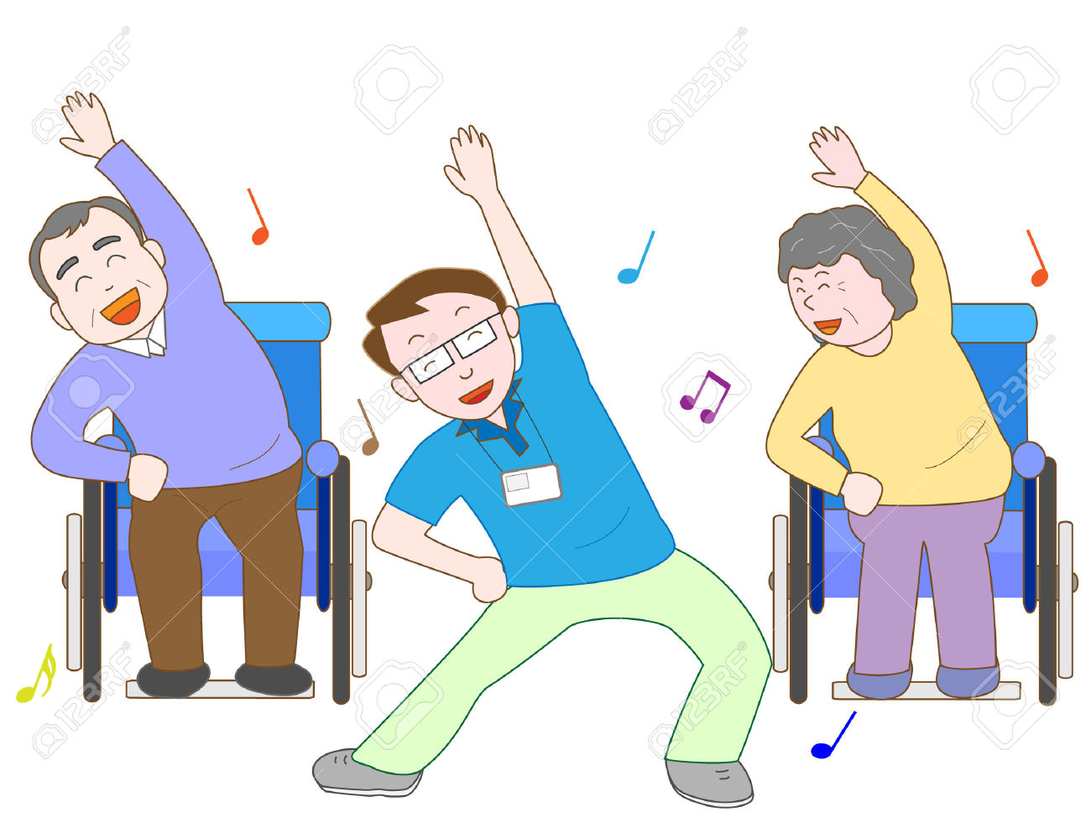
Benefits of seated exercise specifically
Ideal for those who do not exercise regularly
Gentle exercise which is easy to follow
Can be done at home without expensive equipment
Improve mobility and help prevent falls by improving posture and balance
Fun and sociable
Exercises can be modified depending on level of ability or injuries

Slide 5
